Slide 1
IST - Clearing Overview

Slide 2
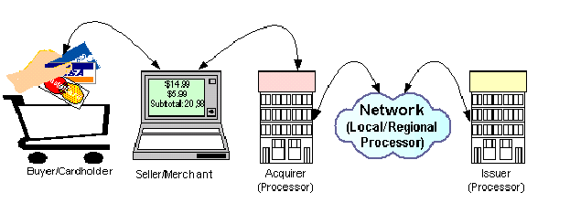

CLEARING

Slide 3
Users of IST – Clearing
Acquirers / Processors - send transaction files
External interfaces:
  Issuer system – to which on-us transaction are routed
  Network – Visa, MC
  Exception system – that provide handling of exception transactions
Internal Processing Interfaces:
MAS – on-us merchant transaction are sent for settlement

Slide 4
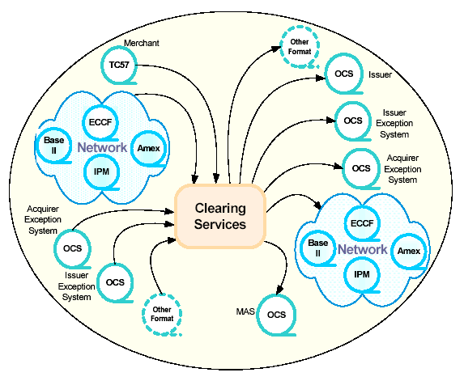
Clearing - Transaction

Slide 5
Transaction Routing
IST/Clearing offers a configurable transaction routing process.
The decision on what processing needs to be done on the transaction depends on the role played as follows:
• Clear to our issuer (‘on-us’ transactions), or
• Clear to a network (‘not on-us’ transactions), possibly serviced by the Interchange product running in a regional processing capacity;
• All transactions that are cleared through networks can also be routed to merchant accounting system (transactions are considered ‘on-us’ merchant transactions, and sent to IST/MAS).

Slide 6
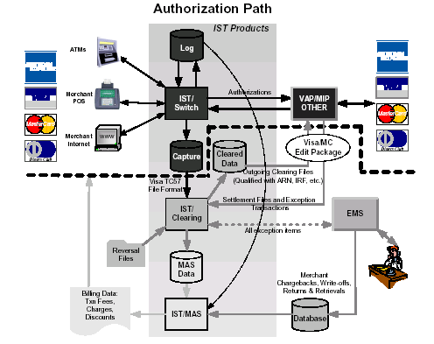


IST – Subsystem Architecture

Slide 7
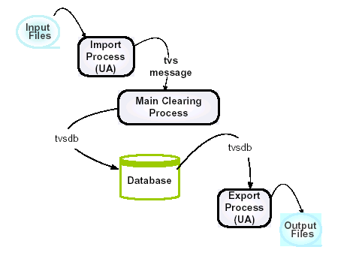
IST Clearing Process Flow

Slide 8
Input File
About Input files…
Transaction Batch file
Files can be from Acquirer, Issuers, Card Associates or EMS
Files can be in IPM, BASE II, TC57 or OCS formats
Files should be copied under pdir/ositeroot/data/in directory
Name of the file should conform to the file_name_mask
configured in Table INST_FILE_TYPE

Slide 9
Import Process
The Import Process imports Clearing messages from various sources like:
Merchant Deposit Capture files imported via TC57 file format
Inbound clearing and settlement files from Card Associations (Visa BaseII, IPM, American Express, etc.)
Exception management system files imported via OCS format

Slide 10
Import Process - Continued…
The Import Process involves three components:
The Scheduler – Instructs the File Recognition task to scan the input file directories at specified periods.
File Recognition – Performs physical integrity, file type and duplicate checking.
Import Process Universal Agent (UA) – The proper Import UA adaptor is called to provide basic syntax editing and conversion to TVS message format. The TVS messages are then sent to the Main Clearing Process for further processing.

Slide 11
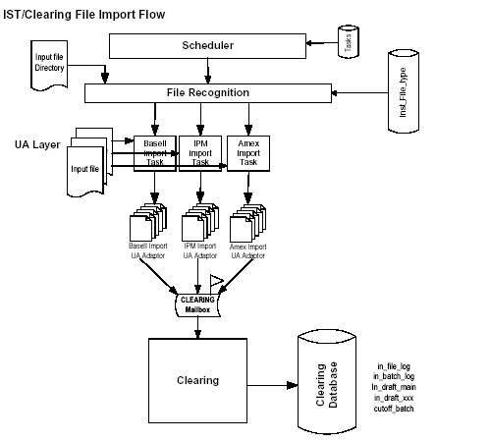
Import Flow

Slide 12
Import Flow – Continued…
The Scheduler
The Scheduler process is configured to run constantly. It scans through the tasks list (as defined in the TASKS table) in a loop. For each task, it sends instructions to the File Recognition task to determine the appropriate file type.
The TASKS table stores tasks the Scheduler must run. Tasks can be configured flexibly.

Slide 13
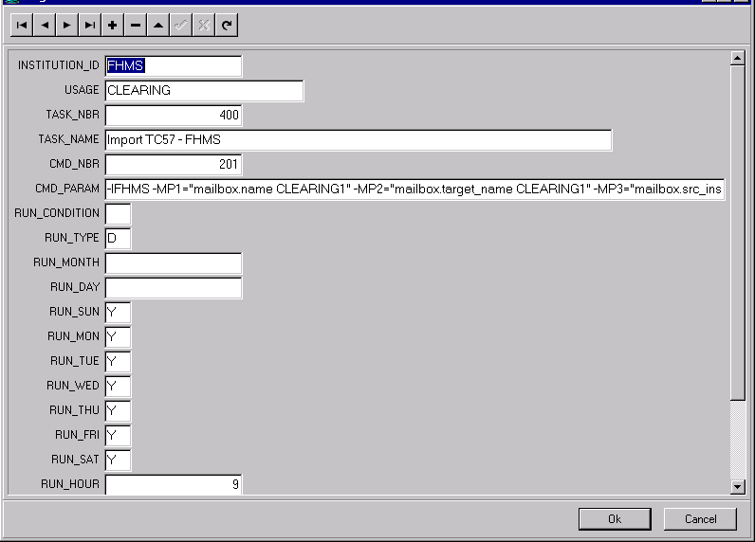
Import Flow – Continued…
Sample entry in Tasks table:

Slide 14
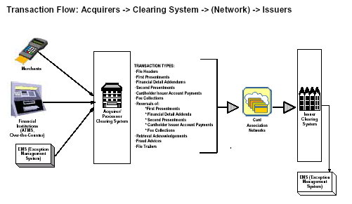
Acquirer – Transaction Flow

Slide 15
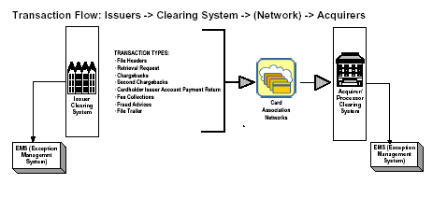
Issuers – Transaction Flow

Slide 16
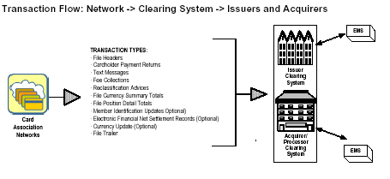
Card Association – Transaction flow

Slide 17
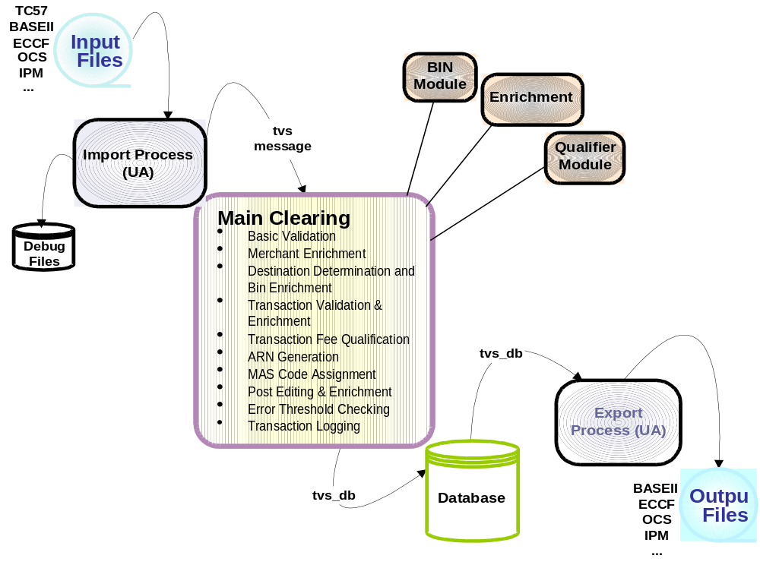
IST/Clearing Processing Flow

Slide 18
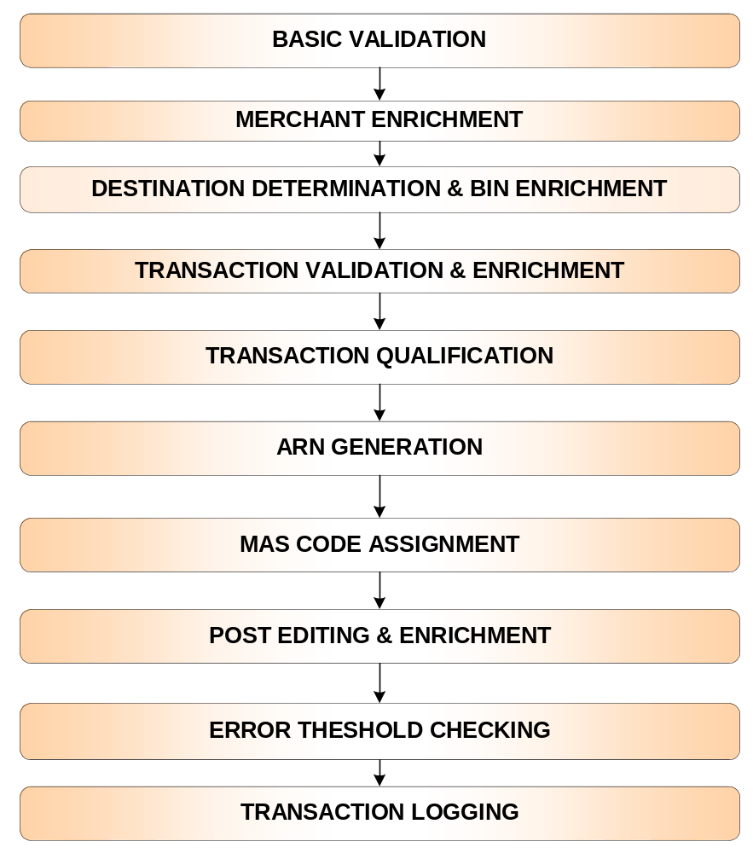
Main Clearing Process Features

Slide 19
Basic Validation
Series of checks are done to make sure that essential information is present and correctly formatted in a transaction message.
Basic Transaction Validation is the first step validation and is essential for further processing.
After the basic validation is completed, if one or more errors are reported (error-threshold is configurable), the transaction is declared non-valid for further processing and suspended.
Processing continues with the validation of the next transaction if there are no errors.

Slide 20
Basic Validation - Continued…
Sample Basic Validation Criteria:
The PAN must be numeric and must be of correct length, as
configured in MBR_BIN and BIN tables.
The purchase date should be a valid date.

Slide 21
Merchant Enrichment
Merchant Enrichment is the process of enriching transactions from merchant files with relevant merchant data.
Enrichment is needed in order to provide correct outgoing data for all Card Associations, and to qualify for the best interchange rate fee qualification.

Slide 22
Merchant Enrichment - Continued…
Merchant Enrichment depends mainly on the following:
Transaction Source Institution – The POS Service Provider, Merchant Data Capture System, or Acquirer System may have different processing systems and capabilities.
Source file type/format – Source institutions may have more than one file type/format.
Destination type/format – Different destinations dictate different requirements.

Slide 23
Merchant Enrichment - Continued…
The following indicators can be configured by the user in the database based on the source institution ID and the incoming File format.
Forced – enriches all fields in the transaction, regardless of whether they are provided or not.
Only Empty Fields – enriches only the fields not provided in the transaction, this will be the most commonly used method.
Skip – no merchant enrichment will be performed. This is done when the user is sure that all merchant data necessary for the system operation will be provided with the transactions.

Slide 24
Merchant Enrichment - Continued…
Sample Merchant Enrichment:
For a Visa transaction, add the merchant’s VISA MPS (Merchant Profile Service) Identification Number, DBA (Doing Business As) Name and legal name.
Part of merchant enrichment is transaction validation, i.e. a set of mandatory edit conditions set by the Card Associations. For example, there must be a corresponding entry for the merchant ID in the AQUIRING_ENTITY table.

Slide 25
Core Entity Services (CES):
Destination Determination and BIN Enrichment
The Transaction Routing process determines where a transaction is coming from and where it is going.
This process involves:
Card Scheme determination – Card scheme is determined based either on the PAN of the incoming transaction, or the BIN.
Transaction direction – The source of the transaction is identified by the BIN, and the destination is determined based on the PAN.

Slide 26
Core Entity Services (CES):
Destination Determination and BIN Enrichment
- Continued…
BIN Enrichment refers to adding such elements as BIN Type, BIN Country Code, etc. BIN enrichment is a type of transaction validation, i.e. a set of mandatory edit conditions set by the Card Associations.
For example, the PAN must fall within the account ranges
listed in the MBR_BIN and BIN tables.

Slide 27
Transaction Validation and Enrichment
General Validation of transactions coming from merchant POS (draft capture) is configured by the user in the Edit Setup forms.
The system comes populated with the basic edit functions, but users will have to update and configure the system according to their business needs.
Sample transaction edits:
If the transaction is from Card Association ”XXX”, the transaction amount must be between USD $.05 and $499,999.99, or the equivalent in a non-US currency.
If the transaction is from Card Association “YYY”, an approval code must be present.

Slide 28
Transaction Fee Qualification
Transaction pre-qualification enrichment (e.g. TGA, Number of Clearing Days)
Qualification IRF Determination
Transaction IRF Qualification

Slide 29
ARN Generation
ARN stands for Acquirer Reference Number. This number uniquely identifies a financial transaction and is echoed in all subsequent message exchanges related to the original transaction.
IST/Clearing enriches each transaction coming from merchants (POS capture) with an appropriate ARN.
Each Card Association or private network has its own rules regarding the contents and structure of the ARN.

Slide 30
MAS Code Assignment
IST/Clearing interfaces with IST/MAS by generating a file of merchant deposit transactions with the required Interchange Rate Program identifiers.
These transactions are then enriched with a MAS code that corresponds to the Interchange Rate Qualification plan. The transactions are then exported to MAS.
The MAS code that is assigned by IST/Clearing allows owners of IST/MAS to charge merchant fees and discounts based on which Interchange Reimbursement or Incentive Rate plan is charged to the acquirer.

Slide 31
Post Editing and Enrichment
Post editing occurs after qualification validation. At the end of processing, the system can provide additional enrichment and checking based on the destination.
Sample Post Edit Criteria:
If Base II format is being used and the transaction qualifies for CPS/Passenger Transport PSIRF, add the “Original Ticket Number” in positions 13 to 25 of Merchant Name.

Slide 32
Error Threshold Checking
The Error Threshold is the maximum number of errors that can be allowed before a transaction, batch, or file is suspended.
These thresholds are set for each institution and, within the institution, for each file type.
Card Associations, as well as institutions themselves, determine the rules for individual transactions, as well as error threshold levels for batches and files. Transactions, batches and files can be suspended based on these rules and thresholds.

Slide 33
Error Threshold Checking - Continued…
IST/Clearing allows users to set error thresholds as follow:
Transaction Threshold – the maximum number of allowed non-critical errors within a single transaction before that transaction is considered non-valid.
Batch Threshold – the maximum number or percentage of allowed non-valid transactions within a batch.
File Threshold – the maximum number or percentage of allowed non-valid batches within a file.
Non-batched Transactions Threshold – the maximum number or percentage of non-valid transactions per file.

Slide 34
Transaction Logging
Once a transaction has been through the main Clearing process, it is logged into the IST/Clearing database.

Slide 35
Multi-Card Scheme Support
IST/Clearing supports various Card Association card schemes and Card Association Product Types:
  VISA
  MasterCard
  Europay
  American Express U.S.A.
  Diner’s Club
  Proprietary Cards

Slide 36
Multi-Network Support
IST/Clearing provides the necessary clearing interfaces with:
VISA Base II
MasterCard IPM
Europay ECCF
American Express U.S.A.
Diner’s Club
These clearing interfaces are capable of receiving or sending transaction files to or from the network.

Slide 37
Multi-Format Processing
IST/Clearing supports the following processing formats:
VISA - Base II
MasterCard - IPM
Europay - ECCF
American Express U.S.A.
Diner’s Club
Oasis Clearing System Format (OCS)

Slide 38
Transaction Suspension and Re-Processing
Throughout the clearing process, errors can occur during different processing steps.
A transaction which fails to meet editing criteria is normally suspended. IST/Clearing offers both full and partial transaction suspension.
The system provides appropriate Transaction Rejection Reason Codes for up to 20 errors per transaction.
Once errors have been removed from suspended transactions, the transactions can be reprocessed.

Slide 39
Partial Transaction Processing
Partial processing is an option specially designed by the IST/Clearing system for Merchant Deposit transactions.
The system provides for the need to pay the merchant or charge for a transaction, even if the transaction cannot be exported to the Card Association due to edit processing errors.
At the same time transactions can be exported to secondary destination – IST MAS

Slide 40
Partial Transaction Processing - Continued…
The processing of transactions for dual destinations can result in one of the following:
A transaction is valid and prepared to be exported to two separate destinations
A transaction is not valid and is suspended for the first destination, but it is valid for the second destination
A transaction is not valid and is suspended for both destinations
Partial processing is a configurable option.The Suspend Log also has a flag indicating which destination/s the transaction is suspended for.

Slide 41
Interface with EMS
Exception Items such as chargebacks, and returned Items can be exported to an EMS system for further follow up and resolution.
Resolved items to be cleared can be imported from EMS and cleared to Card Associations or IST/MAS to debit or credit the merchant.

